Slide 1
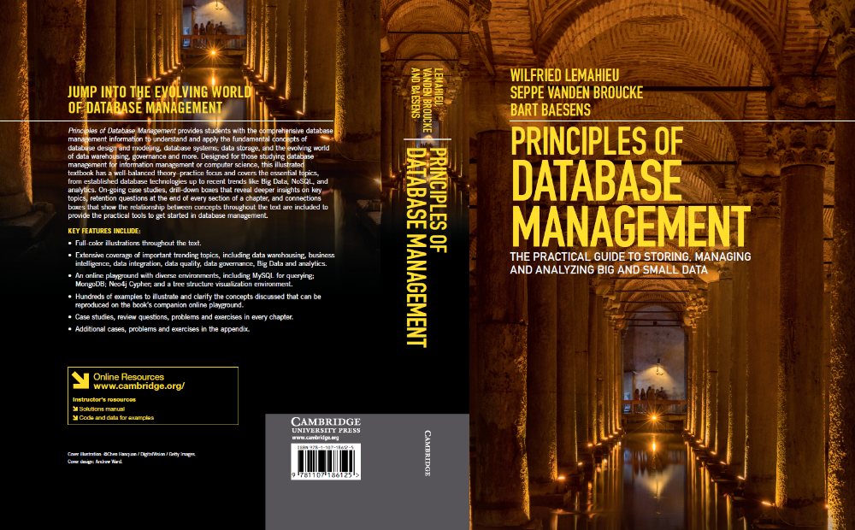
Basics of Transaction Management
www.pdbmbook.com

Slide 2
Introduction
Transactions, Recovery and Concurrency Control
Transactions and Transaction Management
Recovery
Concurrency Control
The ACID Properties of Transactions

Slide 3
Transactions, Recovery and Concurrency control
Majority of databases are multi user databases
Concurrent access to the same data may induce different types of anomalies
Errors may occur in the DBMS or its environment
DBMS must support ACID (Atomicity, Consistency, Isolation, Durability) properties

Slide 4
Transactions, Recovery and Concurrency Control
Transaction: set of database operations induced by a single user or application, that should be considered as one undividable unit of work
  E.g., transfer between two bank accounts of the same customer
Transaction always ‘succeeds’ or ‘fails’ in its entirety
Transaction renders database from one consistent state into another consistent state

Slide 5
Transactions, Recovery and Concurrency Control
Examples of problems: hard disk failure, application/DBMS crash, division by 0, …
Recovery: activity of ensuring that, whichever of the problems occurred, the database is returned to a consistent state without any data loss afterwards
Concurrency control: coordination of transactions that execute simultaneously on the same data so that they do not cause inconsistencies in the data because of mutual interference

Slide 6
Transactions and Transaction Management
Delineating transactions and the transaction lifecycle
DBMS components involved in transaction management
Logfile

Slide 7
Delineating Transactions and the Transaction Lifecycle
Transactions boundaries can be specified implicitly or explicitly
  Explicitly: begin_transaction and end_transaction
  Implicitly: first executable SQL statement
Once the first operation is executed, the transaction is active
If transaction completed successfully, it can be committed. If not, it needs to be rolled back.

Slide 8
Delineating Transactions and the Transaction Lifecycle
<begin_transaction>
UPDATE account
SET balance = balance - :amount
WHERE accountnumber = :account_to_debit
UPDATE account
SET balance = balance + :amount
WHERE accountnumber = :account_to_credit
<end_transaction>

Slide 9
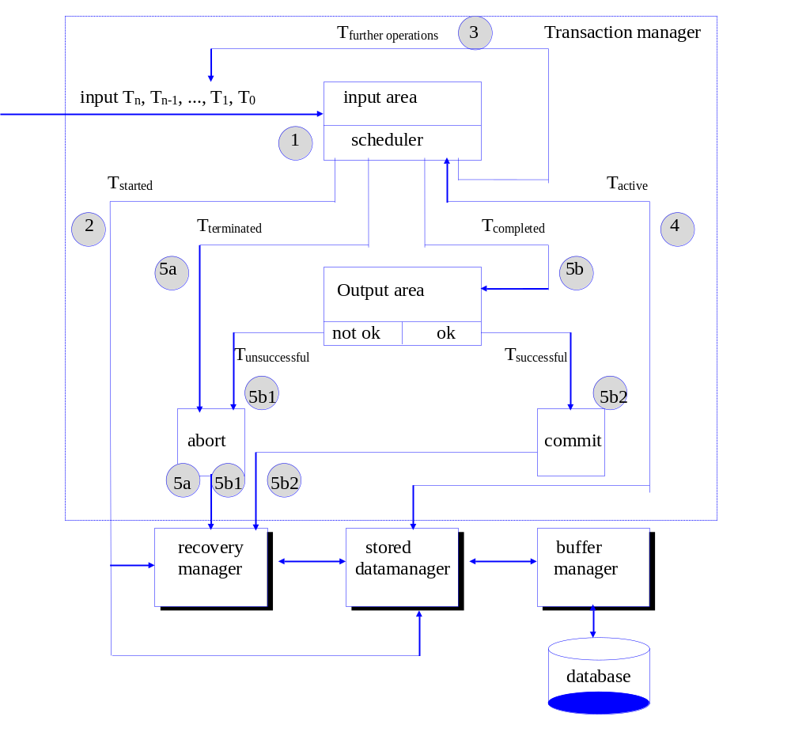
DBMS Components Involved in Transaction Management

Slide 10
Logfile
Logfile registers
  a unique log sequence number
  a unique transaction identifier
  a marking to denote the start of a transaction, along with the transaction’s start time and indication whether the transaction is read only or read/write
  identifiers of the database records involved in the transaction, as well as the operation(s) they were subjected to
  before images of all records that participated in the transaction
  after images of all records that were changed by the transaction
  the current state of the transaction (active, committed or aborted)

Slide 11
Logfile
Logfile may also contain checkpoints
  moments when buffered updates by active transactions, as present in the database buffer, are written to disk at once
Write ahead log strategy
  all updates are registered on the logfile before written to disk
  before images are always recorded on the logfile prior to the actual values being overwritten in the physical database files

Slide 12
Recovery
Types of Failures
System Recovery
Media Recovery

Slide 13
Types of Failures
Transaction failure results from an error in the logic that drives the transaction’s operations and/or in the application logic
System failure occurs if the operating system or the database system crashes
Media failure occurs if the secondary storage is damaged or inaccessible

Slide 14
System Recovery
In case of system failure, 2 types of transactions
  already reached the committed state before failure
  still in an active state
Logfile is essential to take account of which updates were made by which transactions (and when) and to keep track of before images and after images needed for the UNDO and REDO
Database buffer flushing strategy has impact on UNDO and REDO

Slide 15
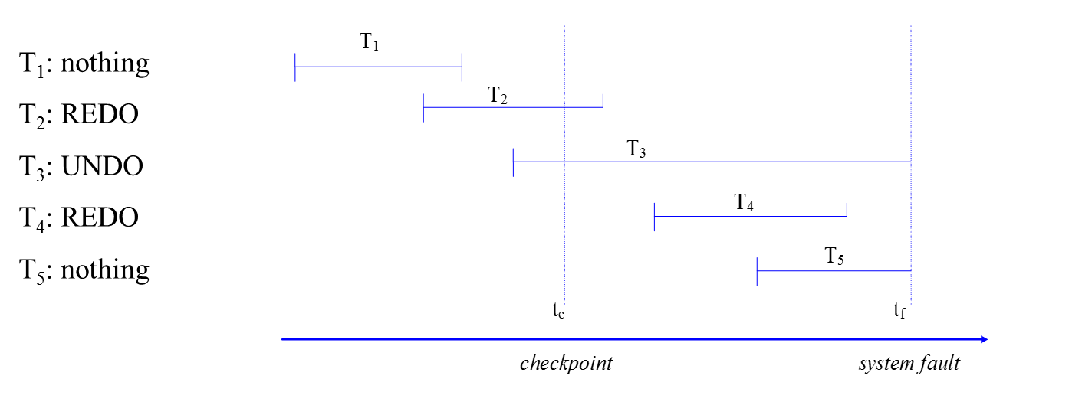
System Recovery
Note 1: checkpoint denotes moment the buffer manager last ‘flushed’ the database buffer to disk!
Note 2: similar reasoning can be applied in case of transaction failure (e.g. T₃, T₅)

Slide 16
Media Recovery
Media recovery is invariably based on some type of data redundancy
  Stored on offline (e.g., a tape vault) or online media (e.g., online backup hard disk drive)
Tradeoff between cost to maintain the redundant data and time needed to restore the system
Two types: disk mirroring and archiving

Slide 17
Media Recovery
Disk mirroring
  a (near) real time approach that writes the same data simultaneously to 2 or more physical disks
  limited failover time but often costlier than archiving
  (limited) negative impact on write performance but opportunities for parallel read access
Archiving
  database files are periodically copied to other storage media (e.g. tape, hard disk)
  trade-off between cost of more frequent backups and cost of lost data
  full versus incremental backup

Slide 18
Media Recovery
Mixed approach: rollfoward recovery
  Archive database files and mirror logfile such that the backup data can be complemented with (a redo of) the more recent transactions as recorded in the logfile
Note: NoSQL databases allow for temporary inconsistency, in return for increased performance (eventual consistency)

Slide 19
Concurrency Control
Typical Concurrency Problems
Schedules and Serial Schedules
Serializable Schedules
Optimistic and Pessimistic Schedulers
Locking and Locking Protocols

Slide 20
Typical Concurrency Problems
Scheduler is responsible for planning the execution of transactions and their operations
Simple serial execution would be very inefficient
Scheduler will ensure that operations of the transactions can be executed in an interleaved way
Interference problems could occur
  lost update problem
  uncommitted dependency problem
  inconsistent analysis problem

Slide 21
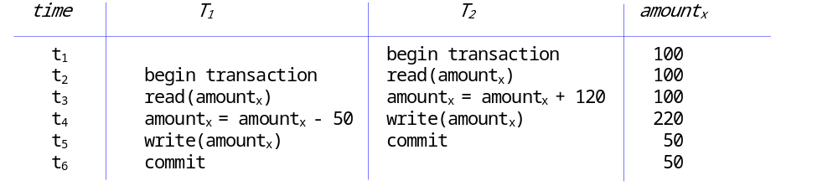
Typical Concurrency Problems
Lost update problem occurs if an otherwise successful update of a data item by a transaction is overwritten by another transaction that wasn’t ‘aware’ of the first update

Slide 22
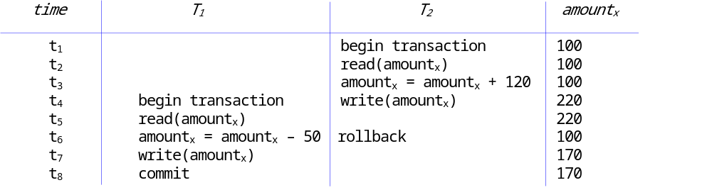
Typical Concurrency Problems
If a transaction reads one or more data items that are being updated by another, as yet uncommitted, transaction, we may run into the uncommitted dependency (a.k.a. dirty read) problem

Slide 23
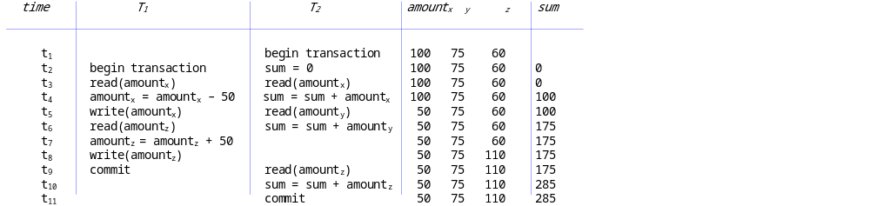
Typical Concurrency Problems
The inconsistent analysis problem denotes a situation where a transaction reads partial results of another transaction that simultaneously interacts with (and updates) the same data items.

Slide 24
Typical Concurrency Problems
Other concurrency related problems
  nonrepeatable read (unrepeatable read) occurs when a transaction T₁ reads the same row multiple times, but obtains different subsequent values, because another transaction T₂ updated this row in the meantime
  phantom reads can occur when a transaction T₂ is executing insert or delete operations on a set of rows that are being read by a transaction T₁

Slide 25
Schedules and Serial Schedules
A schedule S is a set of n transactions, and a sequential ordering over the statements of these transactions, for which the following property holds:
“For each transaction T that participates in a schedule S and for all statements s_{i} and s_{j} that belong to the same transaction T: if statement s_{i} precedes statement s_{j} in T, then s_{i} is scheduled to be executed before s_{j} in S.”
Schedule preserves the ordering of the individual statements within each transaction but allows an arbitrary ordering of statements between transactions

Slide 26
Schedules and Serial Schedules
Schedule S is serial if all statements s_{i} of the same transaction T are scheduled consecutively, without any interleave with statements from a different transaction
Serial schedules prevent parallel transaction execution
We need a non-serial, correct schedule!

Slide 27
Serializable Schedules
A serializable schedule is a non-serial schedule which is equivalent to a serial schedule
2 schedules S₁ and S₂ (with the same transactions T₁, T₂, ..., T_{n}) are equivalent if
  For each operation read_{x} of T_{i} in S₁ the following holds: if a value x that is read by this operation, was last written by an operation write_{x} of a transaction T_{j} in S₁, then that same operation read_{x} of T_{i} in S₂ should read the value of x, as written by the same operation write_{x} of T_{j} in S₂
  For each value x that is affected by a write operation in these schedules, the last write operation write_{x} in schedule S₁, as executed as part of transaction T_{i}, should also be the last write operation on x in schedule S₂, again as part of transaction T_{i}.

Slide 28
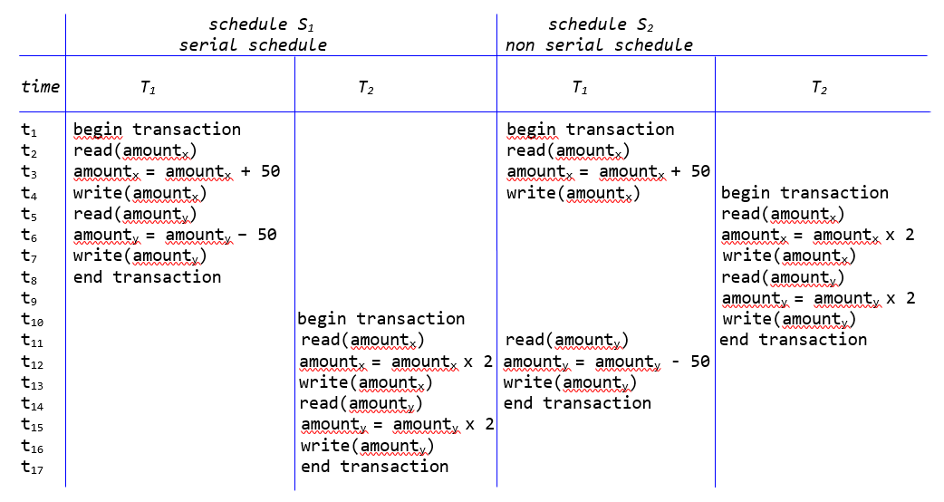
Serializable Schedules

Slide 29
Serializable Schedules
A precedence graph can be drawn to test a schedule for serializability
  create a node for each transaction T_{i}
  create a directed edge T_{i} → T_{j} if T_{j} reads a value after it was written by T_{i}
  create a directed edge T_{i} → T_{j} if T_{j} writes a value after it was read by T_{i}
  create a directed edge T_{i} → T_{j} if T_{j} writes a value after it was written by T_{i}
If precedence graph contains a cycle, the schedule is not serializable.
  E.g., in the previous example, S₂ contains a cycle

Slide 30
Optimistic and Pessimistic Schedulers
Scheduler applies scheduling protocol
Optimistic protocol
  conflicts between simultaneous transactions are exceptional
  transaction’s operations are scheduled without delay
  when transaction is ready to commit, it is verified for conflicts
  if no conflicts, transaction is committed. Otherwise, rolled back.
Pessimistic protocol
  it is likely that transactions will interfere and cause conflicts
  execution of transaction’s operations delayed until scheduler can schedule them in such a way that chance of conflicts is minimized
  will reduce the throughput to some extent
  E.g., a serial scheduler

Slide 31
Optimistic and Pessimistic Schedulers
Locking can be used for optimistic and pessimistic scheduling
  Pessimistic scheduling: locking used to limit the simultaneity of transaction execution
  Optimistic scheduling: locks used to detect conflicts during transaction execution
Timestamping
  Read and write timestamps are attributes associated with a database object
  Timestamps are used to enforce that a set of transactions’ operations is executed in the appropriate order

Slide 32
Locking and Locking Protocols
Purposes of Locking
Two-Phase Locking Protocol (2PL)
Cascading Rollbacks
Dealing with Deadlocks
Isolation Levels
Lock Granularity

Slide 33
Purposes of Locking
Purpose of locking is to ensure that, in situations where different concurrent transactions attempt to access the same database object, access is only granted in such a way that no conflicts can occur
A lock is a variable that is associated with a database object, where the variable’s value constrains the types of operations that are allowed to be executed on the object at that time
Lock manager is responsible for granting locks (locking) and releasing locks (unlocking) by applying a locking protocol

Slide 34
Purposes of Locking
An exclusive lock (x-lock or write lock) means that a single transaction acquires the sole privilege to interact with that specific database object at that time
  no other transactions are allowed to read or write it
A shared lock (s-lock or read lock) guarantees that no other transactions will update that same object for as long as the lock is held
  other transactions may hold a shared lock on that same object as well, however they are only allowed to read it

Slide 35
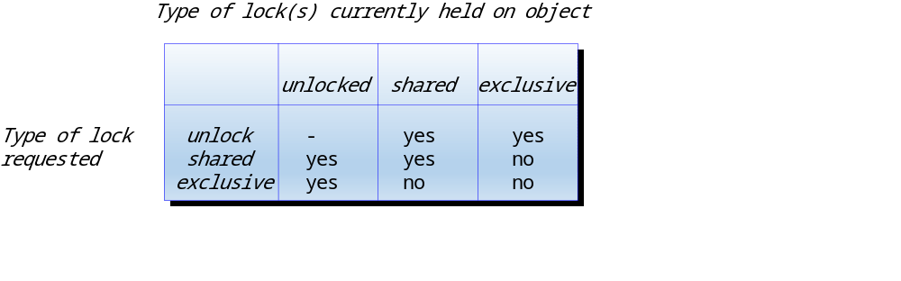
Purposes of Locking
If a transaction wants to update an object, an exclusive lock is required
  only acquired if no other transactions hold any lock on the object
Compatibility matrix

Slide 36
Purposes of Locking
Lock manager implements locking protocol
  set of rules to determine what locks can be granted in what situation (based on e.g. compatibility matrix )
Lock manager also uses a lock table
  which locks are currently held by which transaction, which transactions are waiting to acquire certain locks, etc.
Lock manager needs to ensure ‘fairness’ of transaction scheduling to, e.g., avoid starvation

Slide 37
Two-Phase Locking Protocol (2PL)
2PL locking protocol works as follows:
  Before a transaction can read (update) a database object, it should acquire a shared (exclusive) lock on that object
  Lock manager determines if requested locks can be granted, based on compatibility matri
  Acquiring and releasing locks occurs in 2 phases
    growth phase: locks can be acquired but no locks can be released
    shrink phase: locks are gradually released, and no additional locks can be acquired

Slide 38
Two-Phase Locking Protocol (2PL)
Variants
  Rigorous 2PL: transaction holds all its locks until it is committed
  Static 2PL (Conservative 2PL): transaction acquires all its locks right at the start of the transaction

Slide 39
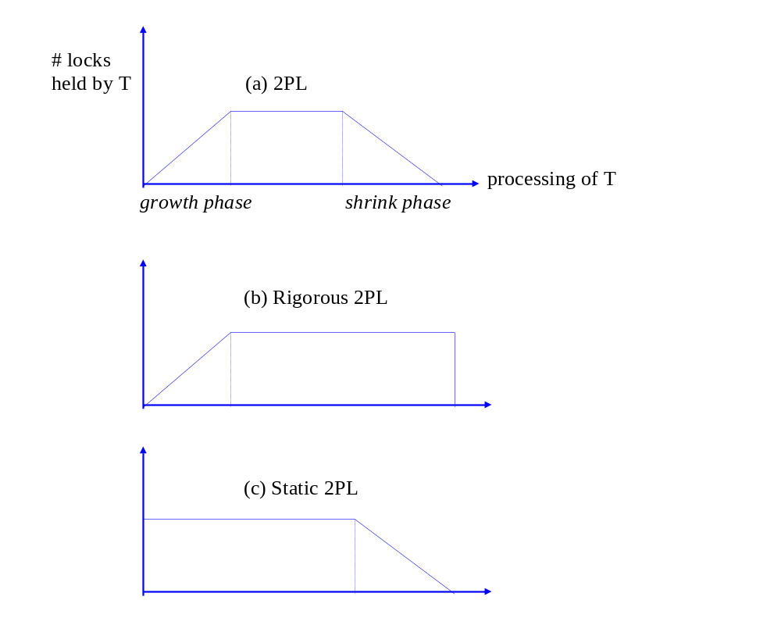
Two-Phase Locking Protocol (2PL)

Slide 40
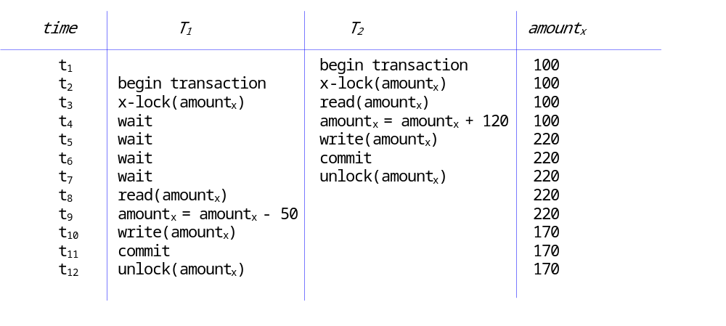
Two-Phase Locking Protocol (2PL)
Lost update problem with locking

Slide 41
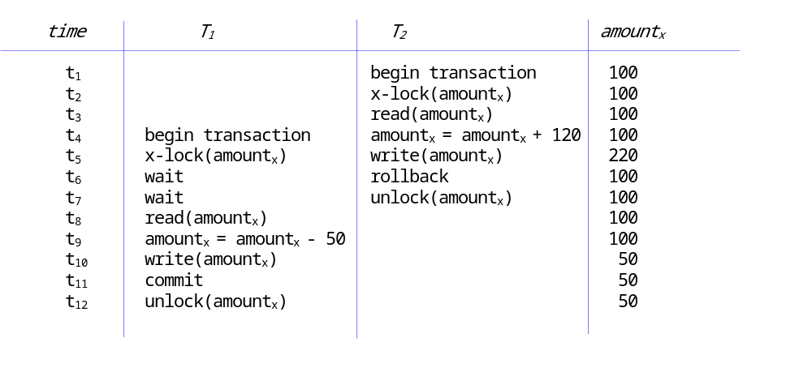
Two-Phase Locking Protocol (2PL)
Uncommitted dependency problem with locking

Slide 42
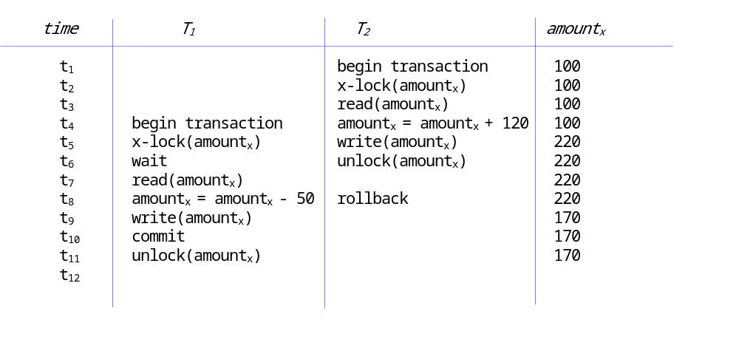
Cascading Rollback
Revisit the uncommitted dependency problem
  problem is resolved if T₂ holds all its locks until it is rolled back
  with 2PL protocol, locks can already be released before the transaction commits or aborts (shrink phase)

Slide 43
Cascading Rollback
Before transaction T₁ can be committed, the DBMS should ensure that all transactions that made changes to data items that were subsequently read by T₁ are committed first
If transaction T₂ is rolled back, all uncommitted transactions T_{u} that have read values written by T₂ need to be rolled back
All transactions that have in their turn read values written by the transactions T_{u} need to be rolled back as well, and so forth
Cascading rollbacks should be applied recursively
  can be time-consuming
  best way to avoid this, is for all transactions to hold their locks until they have reached the ‘committed’ state (e.g., rigorous 2PL)

Slide 44
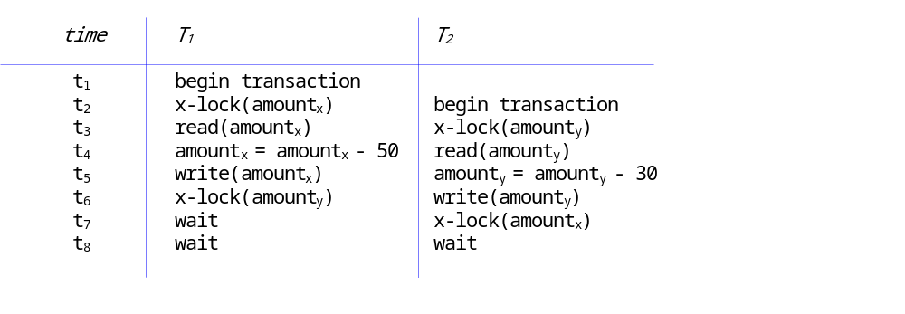
Dealing with Deadlocks
A deadlock occurs if 2 or more transactions are waiting for one another’s’ locks to be released
Example

Slide 45
Dealing with Deadlocks
Deadlock prevention can be achieved by static 2PL
  transaction must acquire all its locks upon the start
Detection and resolution
  wait for graph consisting of nodes representing active transactions and directed edges T_{i} → T_{j} for each transaction T_{i} that is waiting to acquire a lock currently held by transaction T_{j}
  deadlock exists if the wait for graph contains a cycle
  victim selection

Slide 46
Isolation Levels
Level of transaction isolation offered by 2PL may be too stringent
Limited amount of interference may be acceptable for better throughput
Long-term lock is granted and released according to a protocol, and is held for a longer time, until the transaction is committed
A short-term lock is only held during the time interval needed to complete the associated operation
  use of short-term locks violates rule 3 of the 2PL protocol
  can be used to improve throughput!

Slide 47
Isolation Levels
Isolation levels
  Read uncommitted is the lowest isolation level. Long-term locks are not taken into account; it is assumed that concurrency conflicts do not occur or simply that their impact on the transactions with this isolation level are not problematic. This isolation level is typically only allowed for read-only transactions, which do not perform updates anyway.
  Read committed uses long-term write locks, but short-term read locks. In this way, a transaction is guaranteed not to read any data that are still being updated by a yet uncommitted transaction. This resolves the lost update as well as the uncommitted dependency problem. However, the inconsistent analysis problem may still occur with this isolation level, as well as nonrepeatable reads and phantom reads.

Slide 48
Isolation Levels
Isolation levels (contd.)
  Repeatable read uses both long-term read locks and write locks. Thus, a transaction can read the same row repeatedly, without interference from insert, update or delete operations by other transactions. Still, the problem of phantom reads remains unresolved with this isolation level.
  Serializable is the strongest isolation level and corresponds roughly to an implementation of 2PL. Now, phantom reads are also avoided. Note that in practice, the definition of serializability in the context of isolation levels merely comes down to the absence of concurrency problems, such as nonrepeatable reads and phantom reads.

Slide 49
Isolation Levels
Isolation level | Lost update | Uncommitted dependency | Inconsistent analysis | Nonrepeatable read | Phantom read
Read uncommitted | Yes | Yes | Yes | Yes | Yes
Read committed | No | No | Yes | Yes | Yes
Repeatable read | No | No | No | No | Yes
Serializable | No | No | No | No | No

Slide 50
Lock Granularity
Database object for locking can be a tuple, a column, a table, a tablespace, a disk block, etc.
Trade-off between locking overhead and transaction throughput
Many DBMSs provide the option to have the optimal granularity level determined by the database system
Multiple Granularity Locking (MGL) Protocol ensures that the respective transactions that acquired locks on database objects that are interrelated hierarchically cannot conflict with one another

Slide 51
Lock Granularity
MGL protocol introduces additional locks
  intention shared lock (is-lock): only conflicts with x-locks
  intention exclusive lock (ix-lock): conflicts with both x-locks and s-locks
  shared and intention exclusive lock (six-lock): conflicts with all other lock types, except for an is-lock

Slide 52
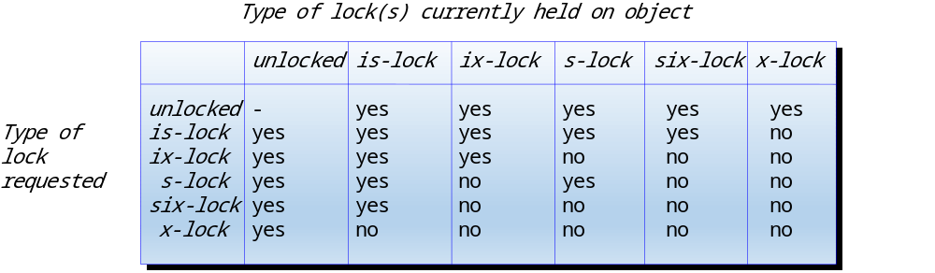
Lock Granularity

Slide 53
Lock Granularity
Before a lock on object x can be granted, an intention lock is placed on all coarser grained objects encompassing x
  E.g., if a transaction requests an s-lock (x-lock) on a particular tuple, an is-lock (ix-lock) will be placed on the corresponding tablespace, table and disk block

Slide 54
Lock Granularity
According to MGL, transaction T_{i} can lock an object that is part of a hierarchical structure, if :
  all compatibilities in the compatibility matrix are respected
  initial lock should be placed on the root of the hierarchy
  before T_{i} can acquire an s-lock or an is-lock on an object x, it should acquire an is-lock or an ix-lock on the parent of x
  before T_{i} can acquire an x-lock, six-lock or an ix-lock on an object x, it should acquire an ix-lock or a six-lock on the parent of x
  T_{i} can only acquire additional locks if it hasn’t released any locks yet
  Before T_{i} can release a lock on x, it should have released all locks on all children of x
In the MGL-Protocol, locks are acquired top-down, but released bottom-up

Slide 55
ACID Properties of Transactions
ACID stands for Atomicity, Consistency, Isolation and Durability
Atomicity guarantees that multiple database operations that alter the database state can be treated as one indivisible unit of work
  recovery manager can induce rollbacks where necessary, by means of UNDO operations
Consistency refers to the fact that a transaction, if executed in isolation, renders the database from one consistent state into another consistent state
  developer is primary responsible
  also an overarching responsibility of the DBMS’s transaction management system

Slide 56
ACID Properties of Transactions
Isolation denotes that, in situations where multiple transactions are executed concurrently, the outcome should be the same as if every transaction were executed in isolation
  responsibility of the concurrency control mechanisms of the DBMS, as coordinated by the scheduler
Durability refers to the fact that the effects of a committed transaction should always be persisted into the database
  Responsibility of recovery manager (e.g. by REDO operations or data redundancy)

Slide 57
Conclusions
Transactions, Recovery and Concurrency Control
Transactions and Transaction Management
Recovery
Concurrency Control
The ACID Properties of Transactions

Slide 58
More information?
www.pdbmbook.com

